Slide 1

SPAM MAIL DETECTION
Om kumar
Sweety kumari
Shresth shaurya

Slide 2
Objective :
To build an intelligent system that accurately detects and filters spam emails using machine learning techniques, enhancing email security and experience.
(1) Reduce the risk of phishing attack.
(2) Enhance user productivity by filtering unwanted messages automatically.

Slide 3

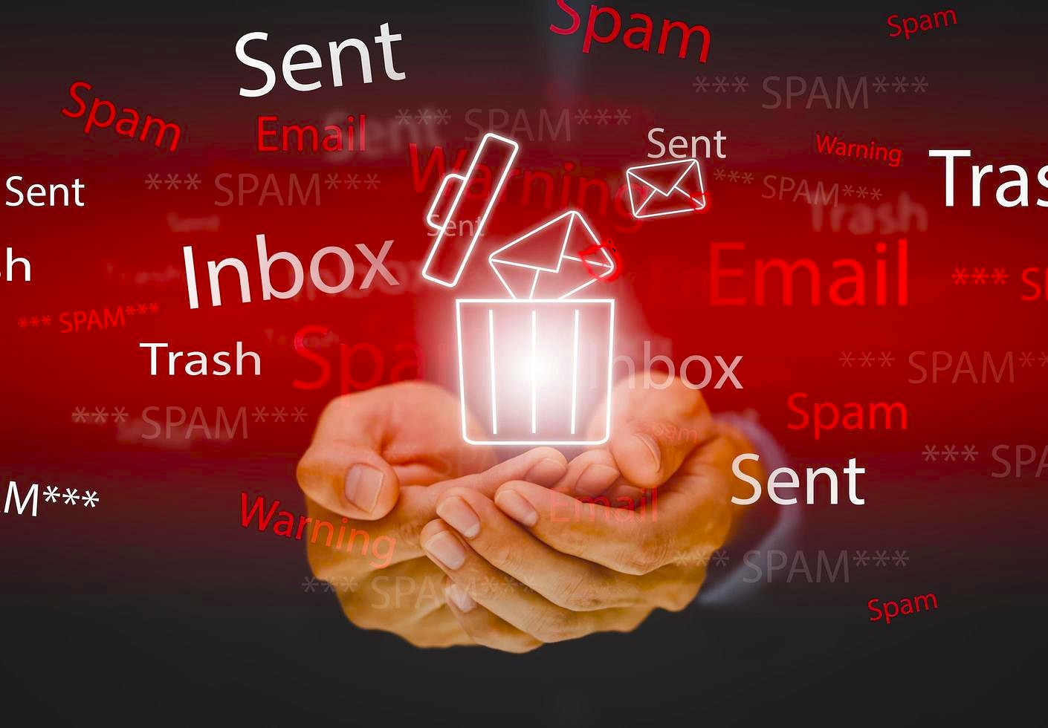

Real-Life Relevance :
Productivity loss:
Spam emails reduce workplace efficiency by cluttering inboxes and distracting users.
Security Risks:
Spam often carries phishing attempts, malware, and fraud risks, threatening sensitive information.
Email Clutter:
Overwhelming amount of spam make managing important emails more difficult and time-consuming.
Proposed Solution:
An automated spam detection system that accurately filters out unwanted emails

Slide 4

Benefits:
Protect users from phishing, malware, and fraud.
Streamlines emails management and improves organization.
Enhances security and operational efficiency.

Slide 5
Applications Across Industries:
Business: Safeguards confidential communications and improves productivity.
Healthcare: Protects sensitive patient data from phishing and breaches.
Education: Secures academic information and ensures smooth communication.

Slide 6
Review of Existing Methods:
Rule-Based Methods:
Emails are analyzed based on handcrafted rules.
Blacklists and Whitelists:
Blacklist for spammers Ips, domains, or email addresses.
Whitelist for trusted senders.
Machine Learning-Based Methods:
It use statistical models trained on past spam/non-spam emails.
Collaborative Filtering/Reputation Systems:
It work on community-based reporting.

Slide 7
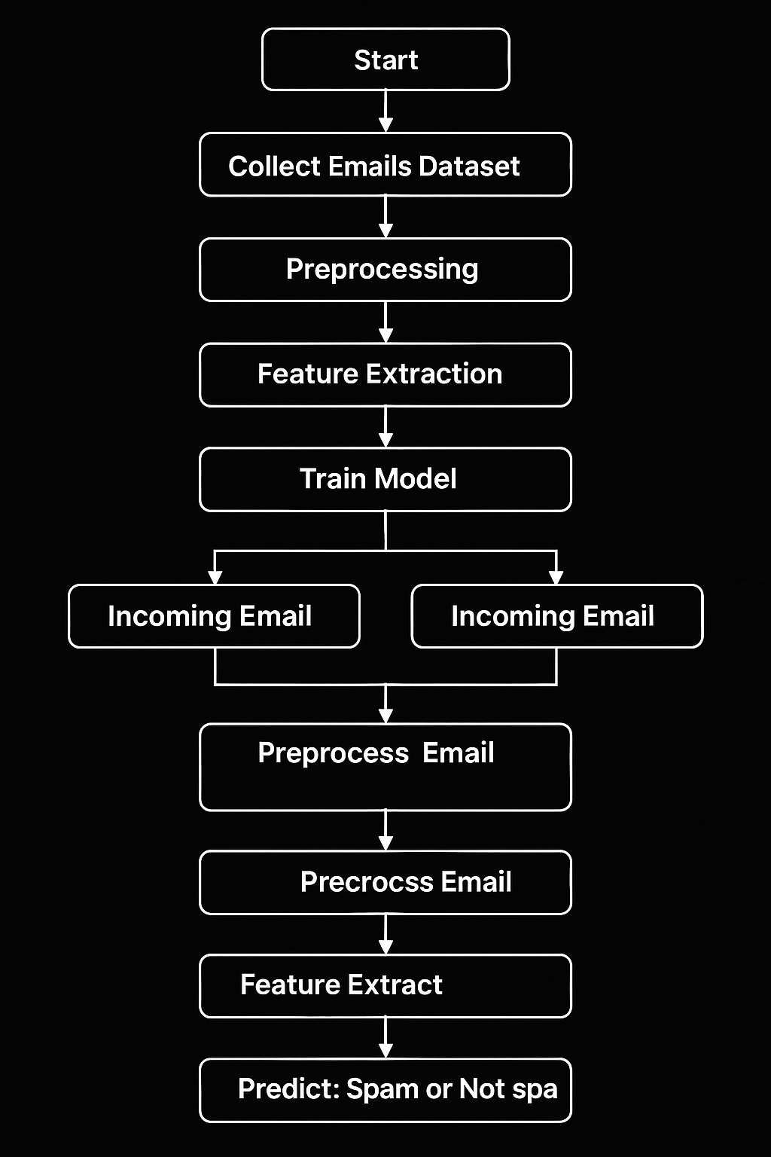
Flow chart/ System Architecture:

Slide 8
Individual/ Group Contribution:
Om Kumar :
Role: Team Leader and Model Developer
Responsibilities: Led the overall project management, coordinated meetings, and oversaw progress. Worked on designing and training the spam detection model, ensuring it met accuracy benchmarks.
Sweety Kumari:
Role: Data preprocessing and Evaluation Specialist.
Shresth Shaurya:
Role: Researcher and Report writer

Slide 9
THANK YOU

